Slide 1
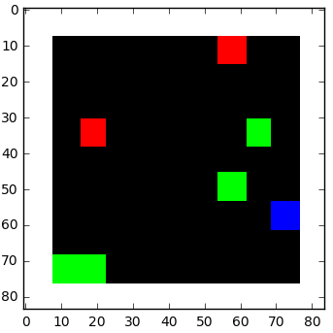
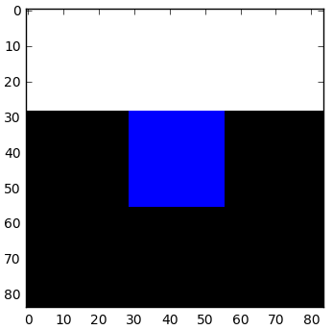
Last Week
This Week
Deep Recurrent Q-Network (DRQN)
-> Fail
Additive Reinforcement Learning Algorithm (ARLA)
New structure with ARLA
FDTD: Lumerical or gprMax

Slide 2
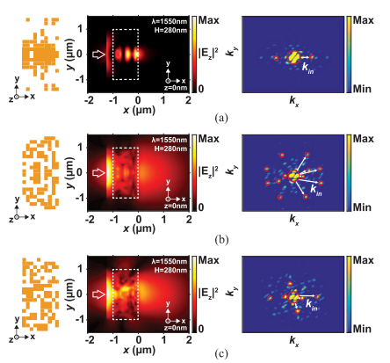
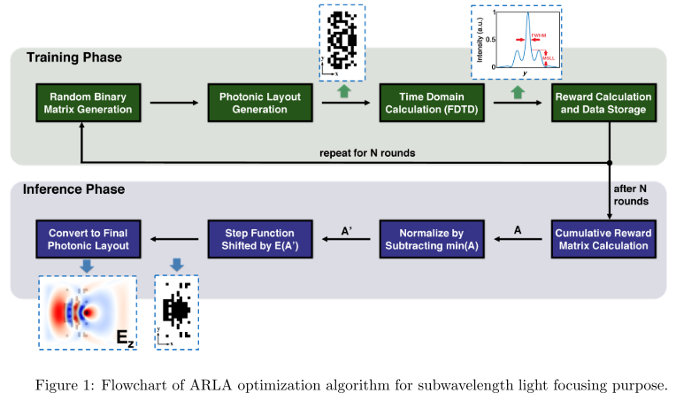
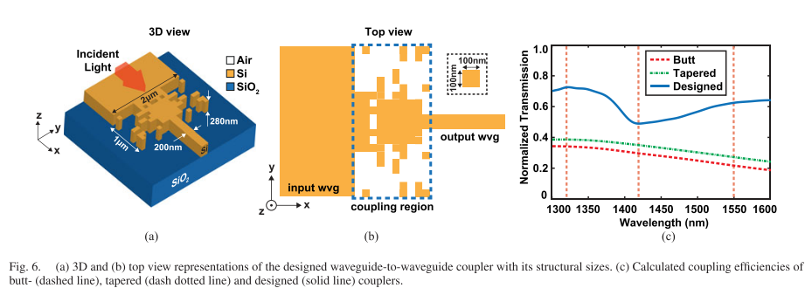
Additive Reinforcement Learning Algorithm (ARLA)
2018-Journal of Lightwave Technology-36, 14-Ultracompact Photonic Structure Design for Strong Light Confinement and Coupling Into Nanowaveguide(Mirbek Turduev, Emre Bor, Cagri Latifoglu, Lbrahim Halil Giden, Y. Sinan Hanay, Hamza Kurt)

Slide 3
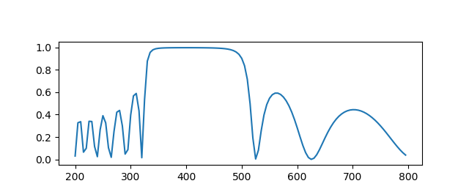
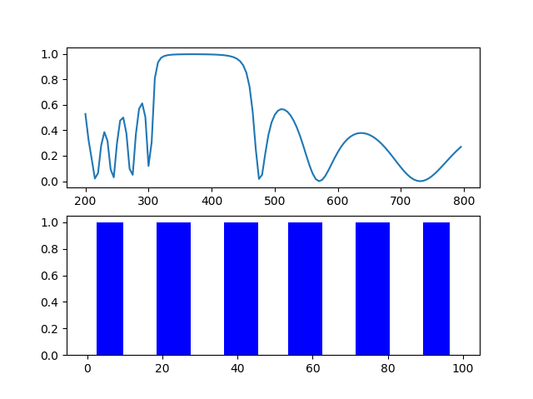
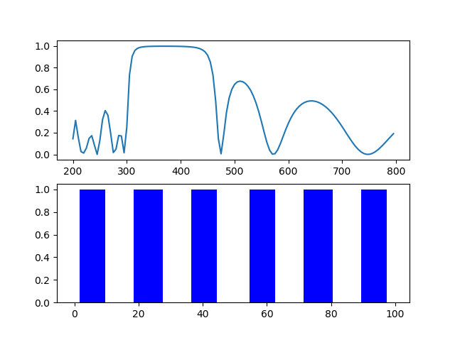



DBR Design with ARLA
N_{pixel}: 100, dx: 5 nm, n_{h}: 2.681 (TiO₂), n_{l}: 1.470 (SiO₂)
$$L=N_{pixel}∗dx$$
Theory
R_{out}
R_{in}
R_{out}
$$dx$$
$$i$$
Reflectivity
…
Wavelength [nm]
ARLA_R_{in} / R_{out}
ARLA_R_{in}*(1-R_{out})
 | score | FWHM | Thickness (nm)
Theory [R_{in} / R_{out}] | 2.167 | 195 | 37, 68, 37, 68, 37, 68, 37, 68, 37, 68, 37
Theory [R_{in}*(1-R_{out})] | 0.538
R_{in} / R_{out} | 2.280 | 165 | 5, 45, 50, 40, 45, 40, 50, 40, 45, 40, 50, 45
R_{in}*(1-R_{out}) | 0.546 | 165 | 10, 40, 45, 45, 45, 40, 50, 40, 45, 45, 45, 40

Slide 4
DBR Design with ARLA
ARLA_R_{in} / R_{out}
ARLA_R_{in}(1-R_{out})
Reflectivity
Reflectivity
Wavelength [nm]
Wavelength [nm]
1: High index material, 0: Low index material

Slide 5



Additive Reinforcement Learning Algorithm (ARLA)
2017-arXiv:1701.06167-Binary Matrix Guessing Problem (Cagrl Latifoglu)
Alice creates an ‘n’ binary sequence A
Bob try to guess A (A is hidden from Bob)
Bob submits a guess B
The scoring function f takes A and B as inputs and returns score s
$$L=N_{pixel}∗dx$$
$$dx$$
$$i$$
…
High index material -> 1, Low index material -> 0
=> Binary Sequence Guessing Problem

Slide 6
Additive Reinforcement Learning Algorithm (ARLA)
Sequences
scores
Sequences * scores
1 | 0 | 1 | 0 | 1
5
5 | 0 | 5 | 0 | 5
1 | 1 | 0 | 0 | 1
6
Sequence * score
6 | 6 | 0 | 0 | 6
Sum
0 | 0 | 1 | 0 | 0
2
0 | 0 | 2 | 0 | 0
0 | 1 | 1 | 1 | 1
8
0 | 8 | 8 | 8 | 8
Substract min.(=8)
11 | 14 | 15 | 8 | 19
3 | 6 | 7 | 0 | 11
Average = 5.4
e_{i}> average: 1
e_{i}< average: 0
Result sequence
0 | 1 | 1 | 0 | 1

